Slide 1
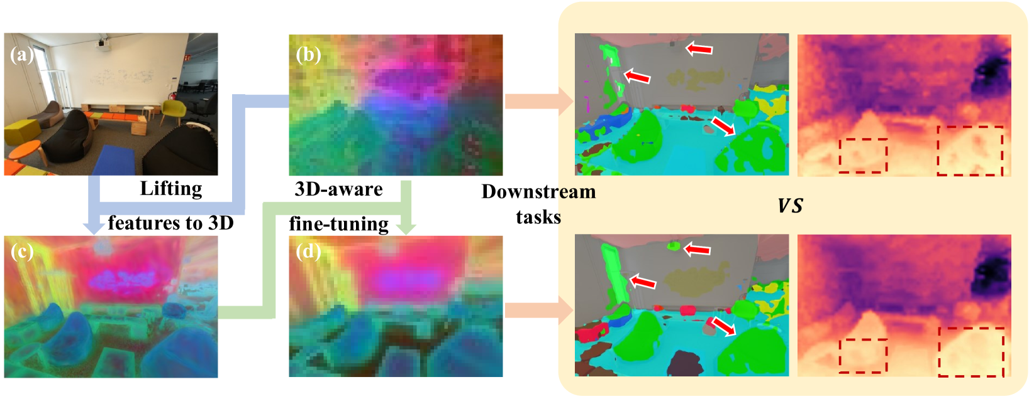
FiT3D
Improving 2D Feature Representations by 3D-Aware Fine-Tuning

Slide 2
Introduction to the problem
Problem → Current vision models trained on 2D images lack true 3D scene understanding.
Motivation → Human vision uses 3D structure cues for better understanding. Models should do the same.
Proposal → A two-stage pipeline
  Lift 2D features to a 3D Gaussian representation
  Use the rendered 3D-aware features to fine-tune 2D models.

Slide 3
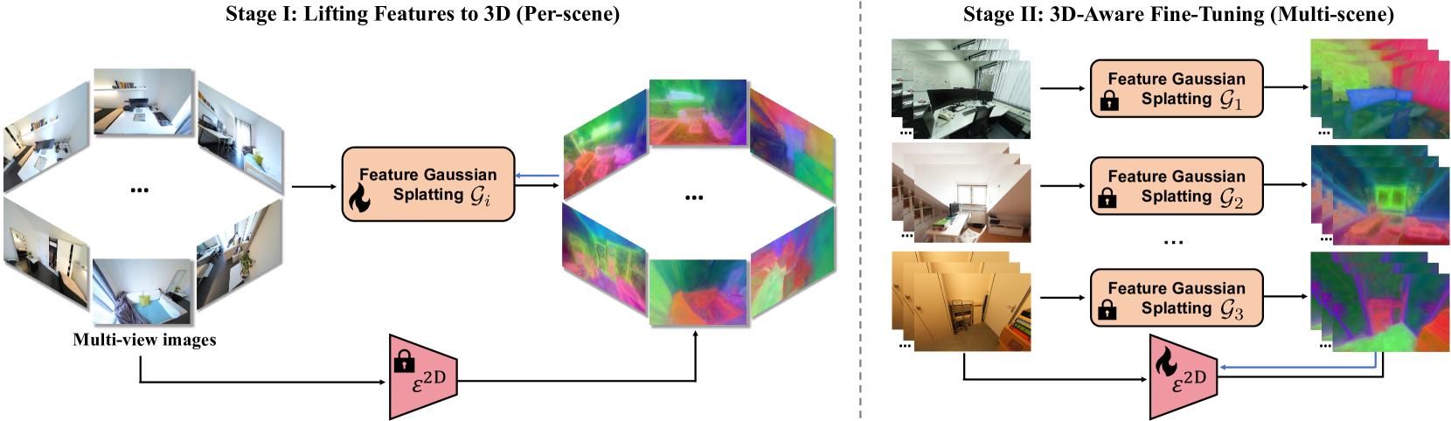
Method
Lifting features to 3D with Feature Gaussian Splatting
Fine-Tuning models with 3D-Awareness

Slide 4
Stage 1, Lifting features to 3D: How?
Multi-view 2D features are encoded into 3D Gaussians
A 3D Gaussian in this context represents a spatial point with appearance and feature attributes
Where:
Mu is the position
s is the scale, R the rotation
Alpha is the opacity
SH is the colour parameters
f is a low-dim feature vector distilled from 2D features

Slide 5
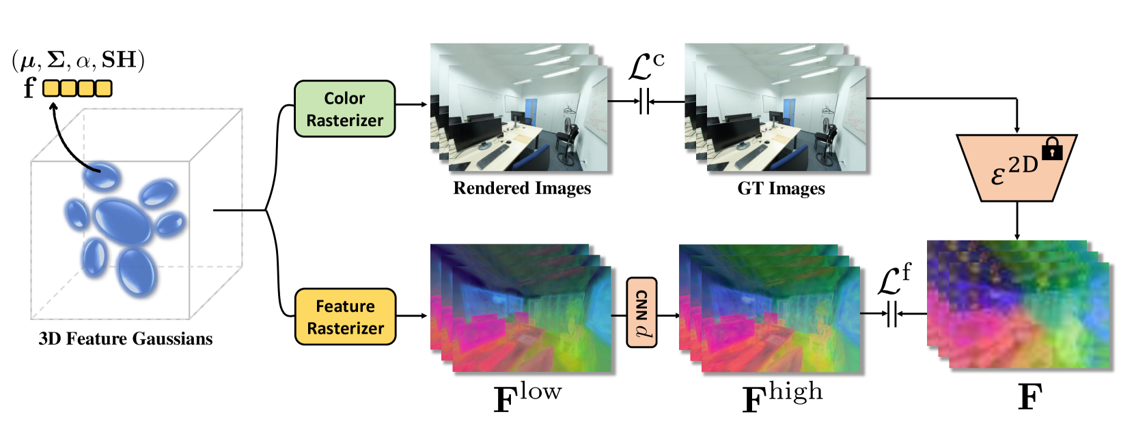
3D Gaussian Splats and Feature Rasterization
To convert 3D Gaussians to a 2D feature image, we use a differentiable rasterizer: Alpha compositing, summing constribution of overlapping Gaussians
A small scene-specific CNN is trained to transpose low-dim features back to high-dim space after rendering

Slide 6
Step 2: 3D-Aware Fine-Tuning
The Fine-Tuning algorithm is summarized as follows:
  Load the 3D Gaussians into CPU memory
  Each training step:
    Sample a training image 𝐼𝑖 and its camera pose 𝑃𝑖.
    Retrieve the corresponding 3D Gaussian 𝐺 and scene-specific CNN decoder 𝑑
    Render the 3D-aware features for the current view using 𝐺 and 𝑑
    Compute L1 loss between rendered features and 2D model output
    Update Theta via backpropagation

Slide 7
Linear Probing for Downstream Tasks
Evaluation is done by training a shallow linear layer on top of extracted features (Linear Probing)
Semantic segmentation → Done trough ViT tokens (patches), with the output upsampled to full resolution
Depth Estimation → [CLS] token combined with each pathc’s feature to map them to depth bin probabilities and selects one from it, using cross-entropy as classification loss

Slide 8
Experiments
Evaluation
  Linear probing on semantic segmentation and depth estimation
Models tested
  DINOv2 (Main)
  CLIP, MAE, DeiT-III (for generalization)
injecting 3D-awareness into 2D models improves performance on vision tasks?

Slide 9
Key Results
3D-aware features consistently outperform baseline DINOv2 on indoor datasets (ScanNet++, NYUv2, ScanNet).
Semantic Segmentation (mean Intersection over Union ↑)
  +2.6% on ScanNet++
  +2.0% on NYUv2
  +1.2% on ScanNet
Depth Estimation (Root Mean Square Error ↓)
  0.37 → 0.34 on ScanNet++
  0.44 → 0.42 on NYUv2
  0.31 → 0.29 on ScanNet

